Slide 1

Building Robust & Scalable Recommendation Systems for Online Food Delivery
Raghav Bali
Staff Data Scientist @ Delivery Hero

Slide 2



Raghav Bali
Staff Data Scientist @ Delivery Hero
A decade-long journey of pioneering enterprise-level solutions. Harnessing Machine Learning, Deep Learning, Computer Vision, NLP and Recommendation Systems

Slide 3

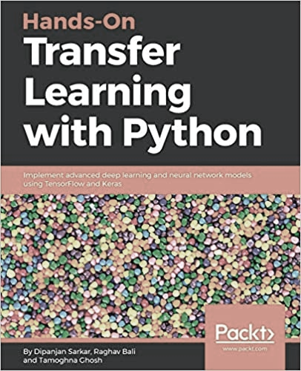
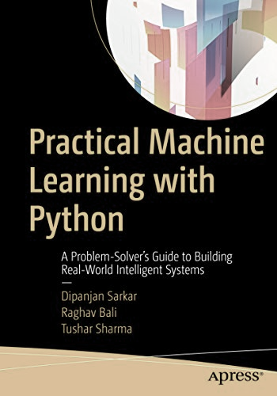

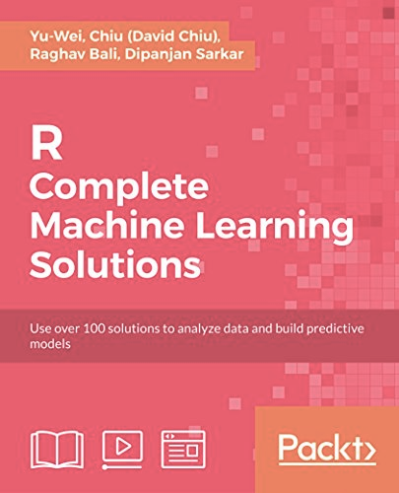
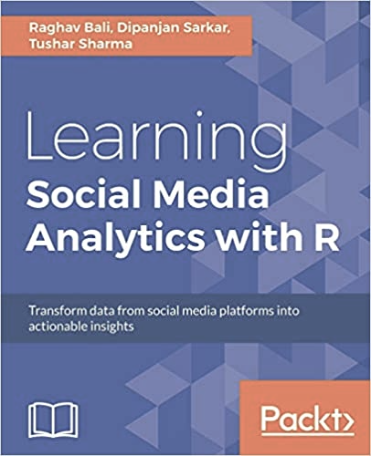
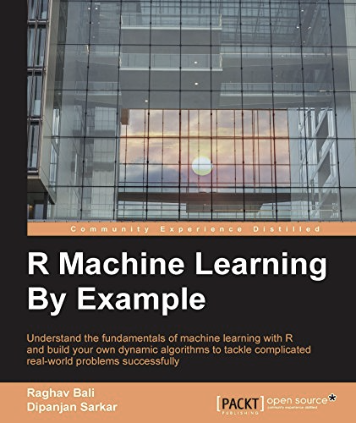
Publications
Multiple patents in the field of mixed reality, deep learning, CV, NLP and Healthcare
A number of papers at peer-reviewed conferences
Well received books on Generative AI, NLP, Transfer Learning and more…

Slide 4

Agenda
Why Recommend?
Popular Use-Cases
Top Challenges
How to Recommend
Key Concepts & Steps
Different Approaches
Evaluate and Optimize Recommendations
Key Metrics
A/B Tests & Beyond
Robustness & Scalability
Addressing Scale & Robustness
Let Us Recommend

Slide 5
Why Recommend

Slide 6

Why Recommend
Preferences
Discovery
Choice Overload

Slide 7






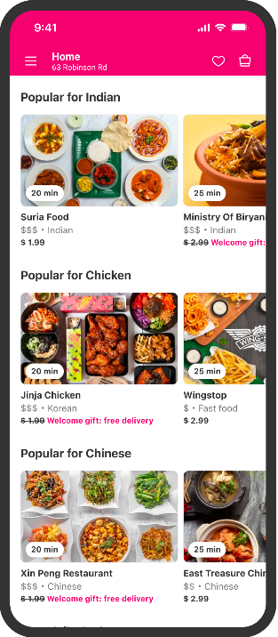














Slide 8

Popular Applications
E-Commerce
Streaming Services
Online Food Delivery
Social Media Platforms
News
Travel Platforms
Gaming Platforms

Slide 9

Top Challenges
Data Availability
Cold-Start
Changing Preferences
Changing Catalogue
Evolving Categories
Fairness and Long-tail
…

Slide 10
How to Recommend

Slide 11

Key Concepts
Key entities:
user/customer
item/vendor
Signals:
Implicit (clicks, impressions, etc.)
Explicit (ratings, reviews, surveys, etc.)
Context
Fill the missing information with best estimates
Match key entities to each other (user-user, user-item, item-item)

Slide 12
Approaches
Batch Vs Online Recommendations
Explore / Exploit Paradigm
Content Vs Collaborative
…
Heuristics
Business Rules
Domain Knowledge
Popularity
Linear
Implicit features
Matrix Factorization (SVD, NMF, ALS, SLIM)
Deep Learning
Embeddings
SAS-Rec, BART
LLM?
More context and world understanding
P5
Complexity

Slide 13
Evaluate & Optimize Recommendations

Slide 14
Key Metrics
Different metrics help us evaluate different aspects of a recommendation engine.
MRR
Mean Reciprocal Rank
MRR is the average of the reciprocal ranks of results for a sample of queries Q
MAP
Mean Average Precision
Average precision scores at each relevant item in the ranked list of recommendations
NDCG
Normalised Discounted Cumulative Gain
Relevance of recommended items and their ranking, placing higher emphasis on the top-ranked items
More
Recall, Coverage, Diversity, Novelty…

Slide 15

A/B Tests and Beyond
Offline Testing: This involves using historical data to evaluate the performance of the recommendation engine, typically using metrics like precision, recall, MAP, and NDCG
Online Testing (A/B Testing): In this method, two versions (A and B) of the system are compared by dividing the user base into two groups and measuring the impact on key metrics like, conversion rate, etc.

Slide 16
A/B Tests and Beyond
User Studies: This involves gathering qualitative feedback from users about the quality of the recommendations, often through surveys or interviews.
Multi-Armed Bandit Testing: This is a form of online testing where the system dynamically adjusts the proportion of traffic receiving different versions of the recommendation system based on their performance.

Slide 17
Robustness & Scalability

Slide 18
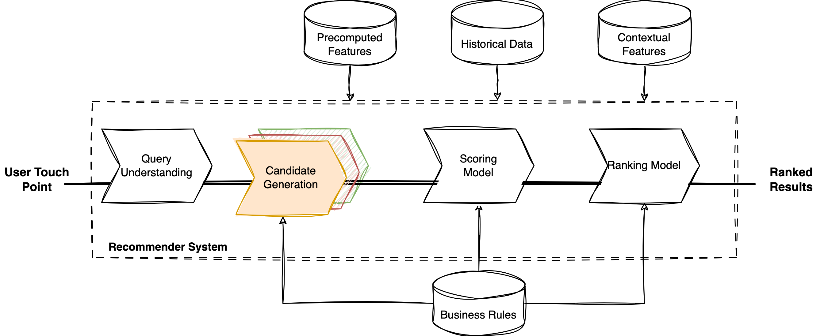
Overall Schematic

Slide 19
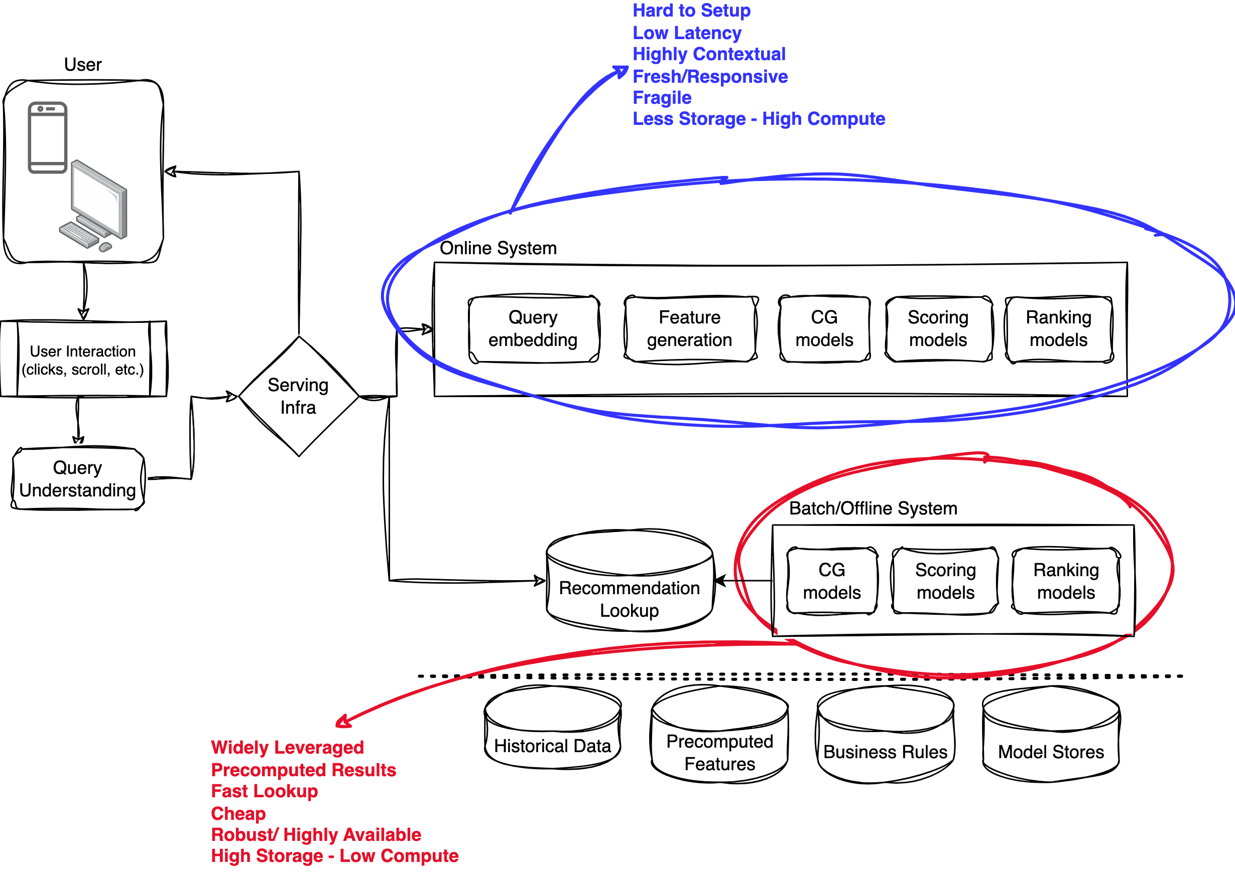
What Scale & Why Robust?
Scale: Delivery Hero brands are serving millions of customers across hundreds of cities across the planet on a daily basis
Robust: Recommendations & Ranking systems are key components for our apps. Their resilience and robustness ensure our customers get best in class experience

Slide 20
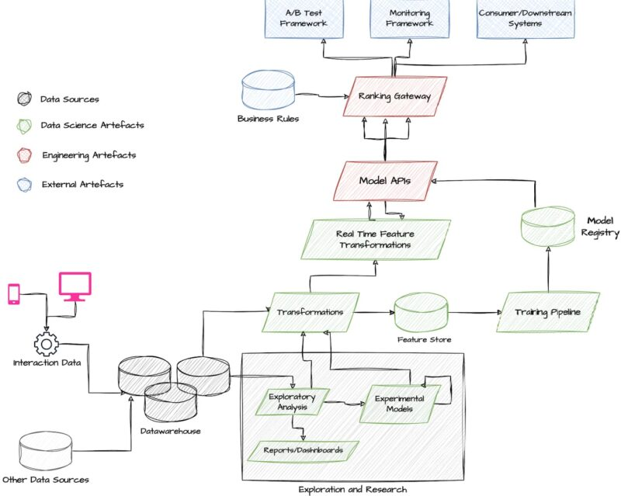
Reference System
Source: https://tech.deliveryhero.com/personalisation-journey-delivery-hero/

Slide 21

Let Us Recommend Hands-On • Quick Demo

Slide 22

!

